Slide 1
Diffuson models
Part 2

Slide 2
Outline
Quick recap of problem
Summary of implementation
Where we left of
Where i am at now
Outlook

Slide 3
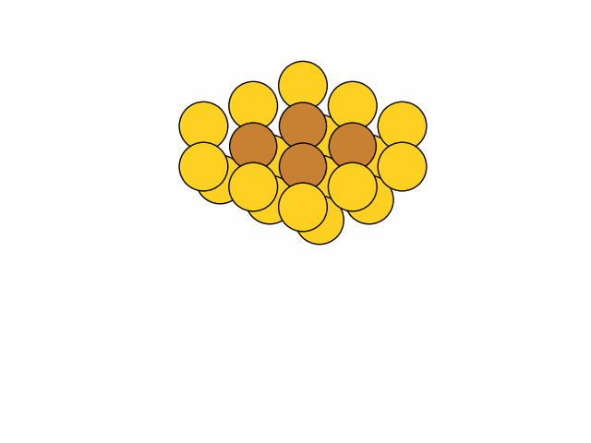
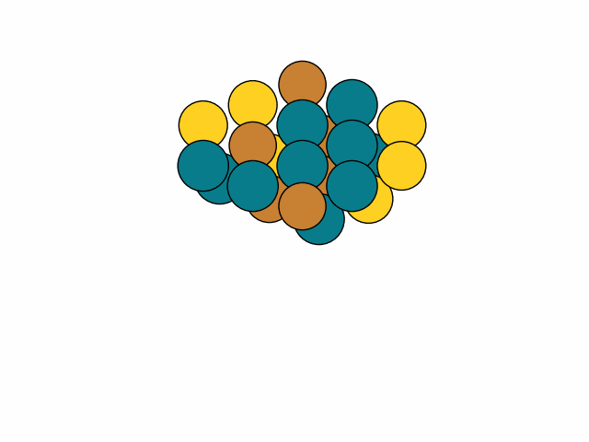
Problem introduction
Investigate RWGS: CO₂ + H₂ ⇌ CO + H₂O on metallic alloys
Example: 111-surface with only 4 active sites
Element pool of 3 yields 3.5billion conf.
Approximation: Ignore effect of stability/geometrical DOF’s.
Swap elements
Reaction rate
Brown: site atoms
Yellow: neighbor atoms

Slide 4
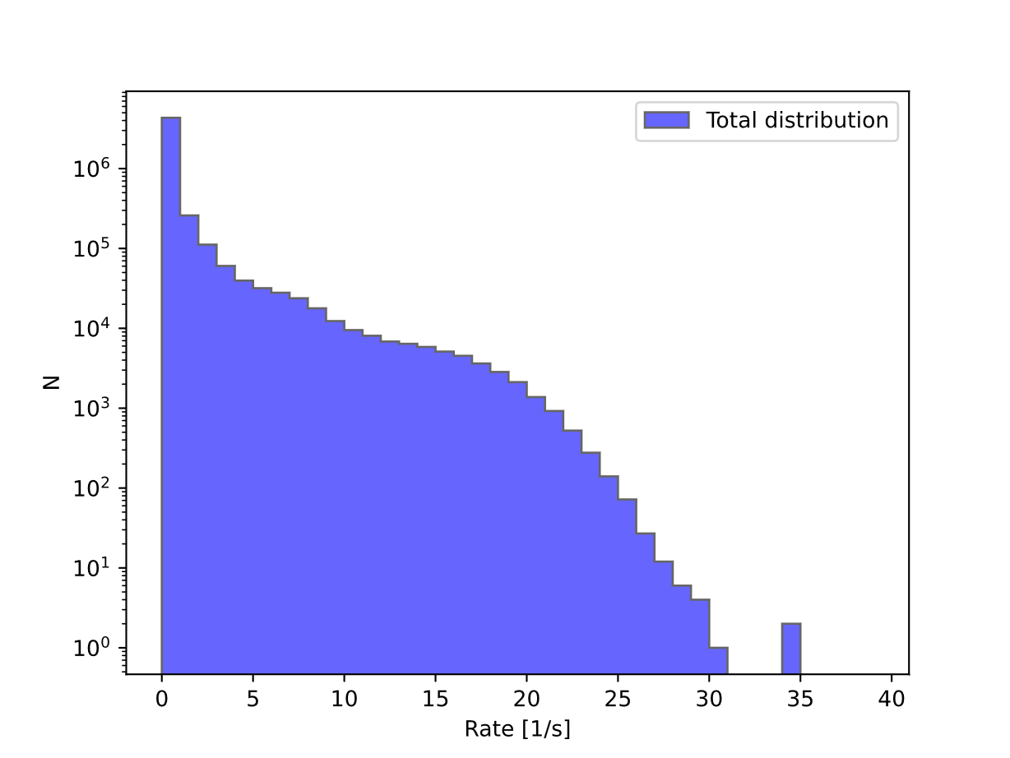
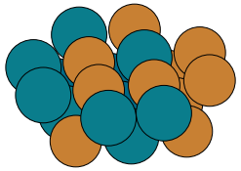
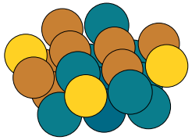
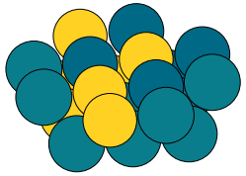
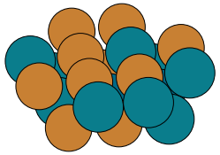
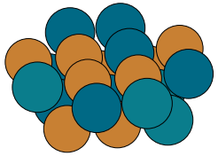
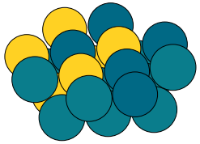
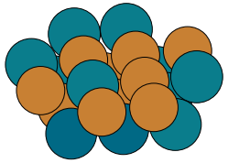
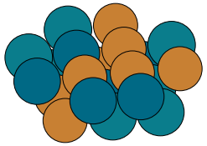
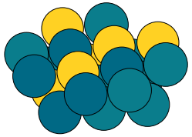
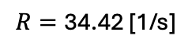
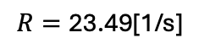
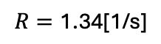
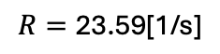
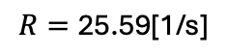
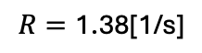
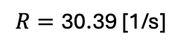
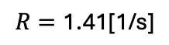
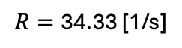
Rates from random sampling
{Rh,Cu,Pd}
{Rh,Cu,Au,Pd}
{Rh,Pd,Au}
$$R=\text{34.4}\text{2 [1/}\text{s}\text{]}$$
$$R=\text{25.5}\text{9[1/}\text{s}\text{]}$$
$$R=\text{1.4}\text{1[1/}\text{s}\text{]}$$
$$R=\text{34.}\text{33 [1/}\text{s}\text{]}$$
$$R=\text{23.5}\text{9[1/}\text{s}\text{]}$$
$$R=\text{1.38}\text{[1/}\text{s}\text{]}$$
$$R=\text{3}\text{0}\text{.}\text{39 [1/}\text{s}\text{]}$$
$$R=\text{23.4}\text{9[1/}\text{s}\text{]}$$
$$R=\text{1.34}\text{[1/}\text{s}\text{]}$$

Slide 5
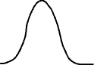
Rates from random sampling
{Rh,Cu,Pd}
{Rh,Cu,Au,Pd}
{Rh,Pd,Au}
$$R=\text{34.4}\text{2 [1/}\text{s}\text{]}$$
$$R=\text{25.5}\text{9[1/}\text{s}\text{]}$$
$$R=\text{1.4}\text{1[1/}\text{s}\text{]}$$
”Generate structures with rates 25/s”
$$R=\text{34.}\text{33 [1/}\text{s}\text{]}$$
$$R=\text{23.5}\text{9[1/}\text{s}\text{]}$$
$$R=\text{1.38}\text{[1/}\text{s}\text{]}$$
$$R=\text{3}\text{0}\text{.}\text{39 [1/}\text{s}\text{]}$$
$$R=\text{23.4}\text{9[1/}\text{s}\text{]}$$
$$R=\text{1.34}\text{[1/}\text{s}\text{]}$$

Slide 6

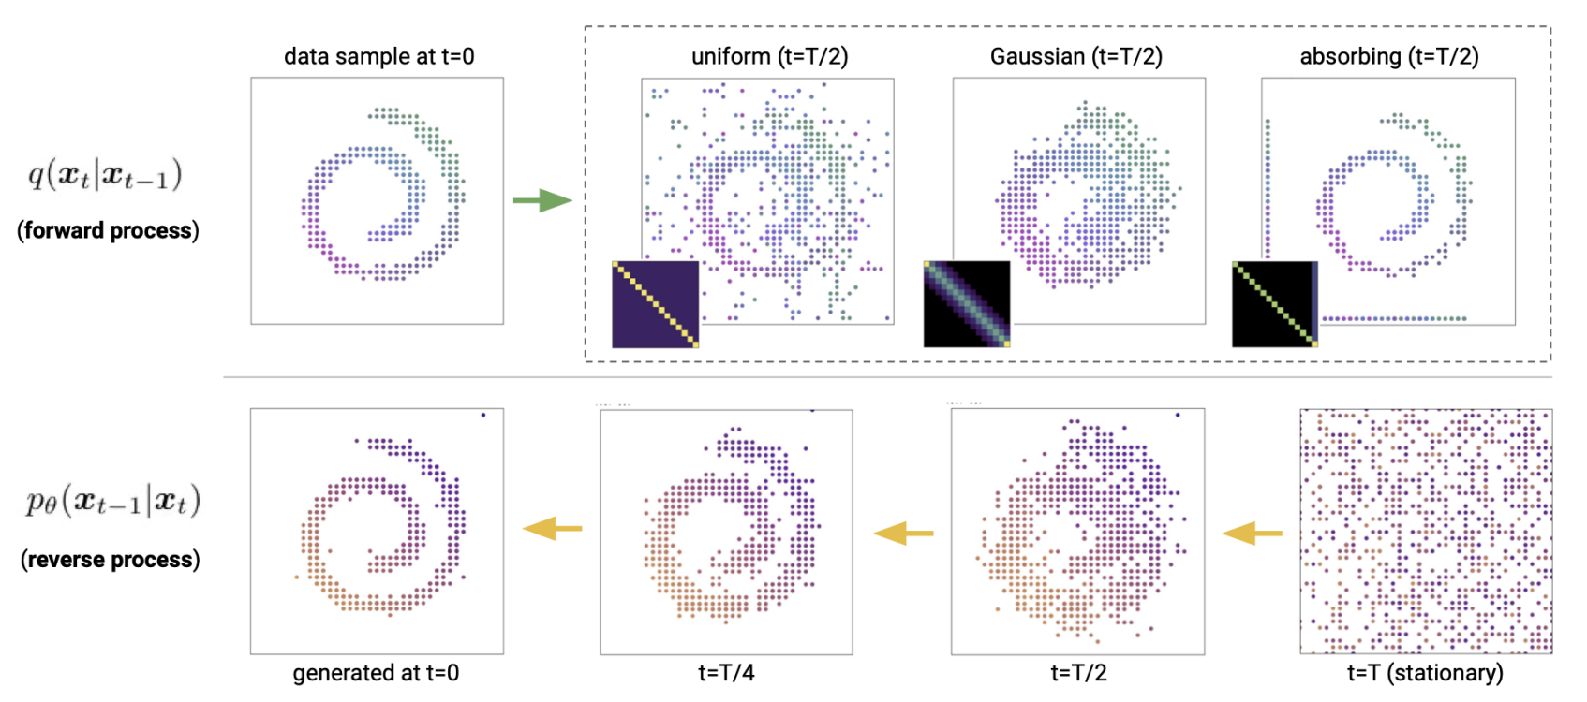
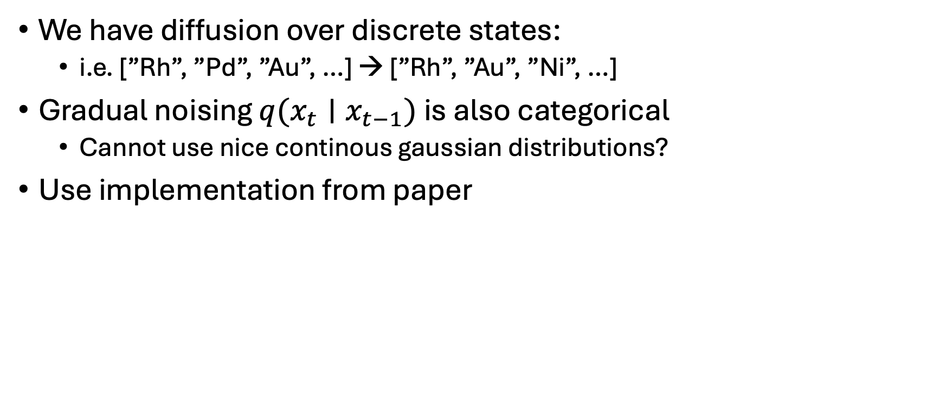
How I implemented this
We have diffusion over discrete states:
i.e. [”Rh”, ”Pd”, ”Au”, …] → [”Rh”, ”Au”, ”Ni”, …]
Gradual noising $q(x_{t}∣x_{t−1})$ is also categorical
Cannot use nice continous gaussian distributions?
Use implementation from paper

Slide 7
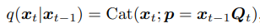
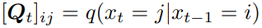
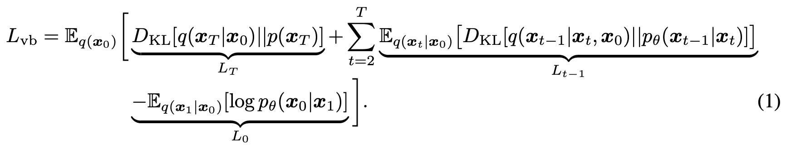
How I implemented this
Paper implements these transitions as:
Q-matrices govern the transfer between different categories
Element pool: [”Rh”, ”Pd”, ”Ni”, ”Au”]
The ”Rh” coloumn/row becomes:
[0.50, 0.20, 0.30, 0.10]
Loss becomes (regular ELBO):
0.50
Rh
0.20
Pd
0.30
0.10
Ni
Au

Slide 8
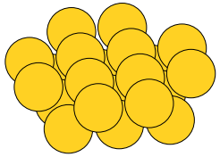
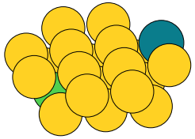
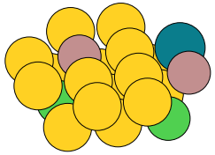
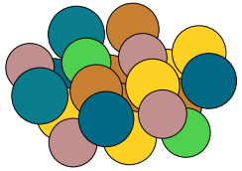
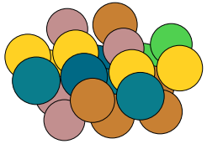
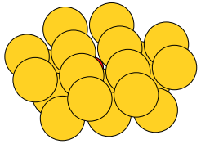
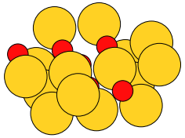
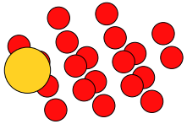
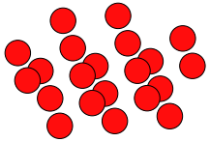
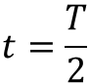
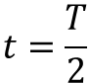
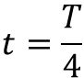
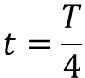
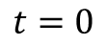
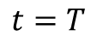
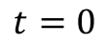
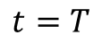
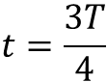
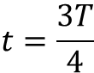
How i implemted this: Diffusion examples
Used Exponential schedule with $β_{t}∈\left[1{⋅10}^{−4},1{⋅10}^{−1}\right]$
Uniform diffusion; $x_{t}∼q(x_{t}|x_{t−1})$
$$t=\frac{T}{4}$$
$$t=\frac{T}{2}$$
$$t=\frac{3T}{4}$$
$$t=T$$
$$t=0$$
Absorbing diffusion; $x_{t}∼q(x_{t}|x_{t−1})$
$$t=\frac{T}{4}$$
$$t=\frac{T}{2}$$
$$t=\frac{3T}{4}$$
$$t=T$$
$$t=0$$

Slide 9
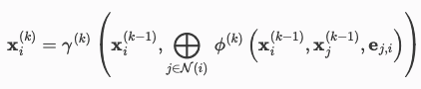
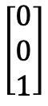
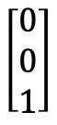
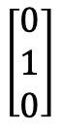











How I implemented this
Scheduling & forward diffusion already talked about
The denoising part: $p_{θ}\left(x_{t−1} ∣ x_{t}\right)$
A GNN using a fully learnable message-passing scheme.
Edges → Bonds
$$\left[\begin{matrix}0 \\ 0 \\ 1\end{matrix}\right]$$
$$\left[\begin{matrix}0 \\ 0 \\ 1\end{matrix}\right]$$
$$\left[\begin{matrix}1 \\ 0 \\ 0\end{matrix}\right]$$
$$\left[\begin{matrix}0 \\ 0 \\ 1\end{matrix}\right]$$
softmax
$$\left[\begin{matrix}0 \\ 0 \\ 1\end{matrix}\right]$$
$$\left[\begin{matrix}1 \\ 0 \\ 0\end{matrix}\right]$$
softmax
$$\left[\begin{matrix}1 \\ 0 \\ 0\end{matrix}\right]$$
$$\left[\begin{matrix}0 \\ 1 \\ 0\end{matrix}\right]$$
$$\left[\begin{matrix}1 \\ 0 \\ 0\end{matrix}\right]$$
$$\left[\begin{matrix}0 \\ 1 \\ 0\end{matrix}\right]$$
Do message passing N-times. At the very end apply softmax , so we get: $p_{θ}(x_{t−1}∣x_{t})$ atom-wisely
Generate $x_{t−1}∼p_{θ}(x_{t−1}∣x_{t})$
Input graph: $x_{t}$

Slide 10







How I implemented this
As mentioned: Could be nice with guidance
Does not change anything in the derivations? Just $p_{θ}(x_{t−1}∣x_{t},c)$
For now only class labels → Embedded into learnable vector $c$
Additionally two MLPs: $γ\left(c\right), β(c)$ which sees the condition
Shifts the inputs of the GNN
$$γ\left(c\right)∗\left[\begin{matrix}1 \\ 0 \\ 0\end{matrix}\right]+β(c)$$
$$γ\left(c\right)∗\left[\begin{matrix}0 \\ 0 \\ 1\end{matrix}\right]+β(c)$$
Class 1: Pure Au
Class 2: Pure Pd
$$γ\left(c\right)∗\left[\begin{matrix}1 \\ 0 \\ 0\end{matrix}\right]+β(c)$$
Do message passing and softmax as shown earlier
$$γ\left(c\right)∗\left[\begin{matrix}1 \\ 0 \\ 0\end{matrix}\right]+β(c)$$
$$γ\left(c\right)∗\left[\begin{matrix}0 \\ 1 \\ 0\end{matrix}\right]+β(c)$$

Slide 11

How I implemented this
Conditioning is used together with classifier free guidance
Sampling then becomes:
$p_{θ}\left(x_{t−1} ∣ x_{t},c\right)=softmax \left[w_{g}GNN\left(x_{t},c\right)+GNN\left(x_{t},∅\right)(1−w_{g}) \right]$
Where $GNN\left(x_{t},c\right)$ means the final representation of the atoms.
$∅$ is a learnable vector for when no condition is applied
For training:
Simply drop the conditon $c$ with some probability $p_{drop}$

Slide 12






Finally: Testing my implementation
Trial dataset: 400 structures 50:50 split between 2 classes
Blue atoms: Pd, Yellow atoms: Au
Set categorical space: $\left[Au, Pd, Rh, Ni, Ga, Cu\right]$
Using Classifier free guidance: Drop probability: 10%
1000 timesteps
Tried both Uniform transitions & Absorbing state
Training set
Class 1
Class 2
Class 1
Class 2
Class 1
Class 2

Slide 13


Finally: Testing my implementation
Absorbing state - Cosine time schedule: $β_{t}∈\left[1{∗10}^{−4};1{∗10}^{−1}\right]$
Guidance scale: 2.0
Conditioned on class 1
Conditioned on class 2

Slide 14











Finally: Testing my implementation
Uniform transitions - Cosine time schedule: $β_{t}∈\left[1{∗10}^{−4};2{∗10}^{−1}\right]$
Guidance scale: 2.0
Conditioned on class 1
Conditioned on class 2

Slide 15
Where we left off – Embedding the rate
2 Approaches:
Class division
Rate embedded directly

Slide 16


Initial tests on class embedding of rates
Tried class-divisions & samples from random search
Element pool: $\left[Au, Pd, Rh, Cu\right]$
Num samples $∼4000$

Slide 17


Sampling results
Trained model uses:
Absorbing state
CosineSchedule, $β_{t}∈\left[1{⋅10}^{−4};1{⋅10}^{−1}\right]$
When training:
Validation set 10% of samples
With early stopping & Learning rate scheduler

Slide 18



Slide 19








Maybe hard to learn?
$$\left[\begin{matrix}1 \\ 0 \\ 0\end{matrix}\right]$$
$$\left[\begin{matrix}0 \\ 0 \\ 1\end{matrix}\right]$$
$$\left[\begin{matrix}1 \\ 0 \\ 0\end{matrix}\right]$$
$$\left[\begin{matrix}1 \\ 0 \\ 0\end{matrix}\right]$$
Tried visualizing data using PCA and t-SNE
Input onehots concatenated into long vector
No clear trends?
$$\left[\begin{matrix}0 \\ 1 \\ 0\end{matrix}\right]$$
$$Graph=\left[\begin{matrix}1 \\ 0 \\ \begin{matrix}0 \\ 1 \\ \begin{matrix}⋮ \\ 0 \\ 1\end{matrix}\end{matrix}\end{matrix}\right]$$

Slide 20

Tried other data distributions
Have genetic algorithm for searching
Should be more distinguishable
Used same model & training settings

Slide 21


Still hard to learn?
More clear trends emerge → Also expected

Slide 22



Slide 23



Slide 24
Conclusions I draw from this
Maybe Rate embedding is too weak?
Loss is also minimized without the condition
Suspect 2 things: Rate too weak or mistake in code
Look at learned embeddings for each class
Make model learn latent space rep. and check
Also have few places in the code i need to recheck
If rate too weak: How do we make stronger?

